Slide 1












Http services, promises and observables
By Santiago Cano

Slide 2
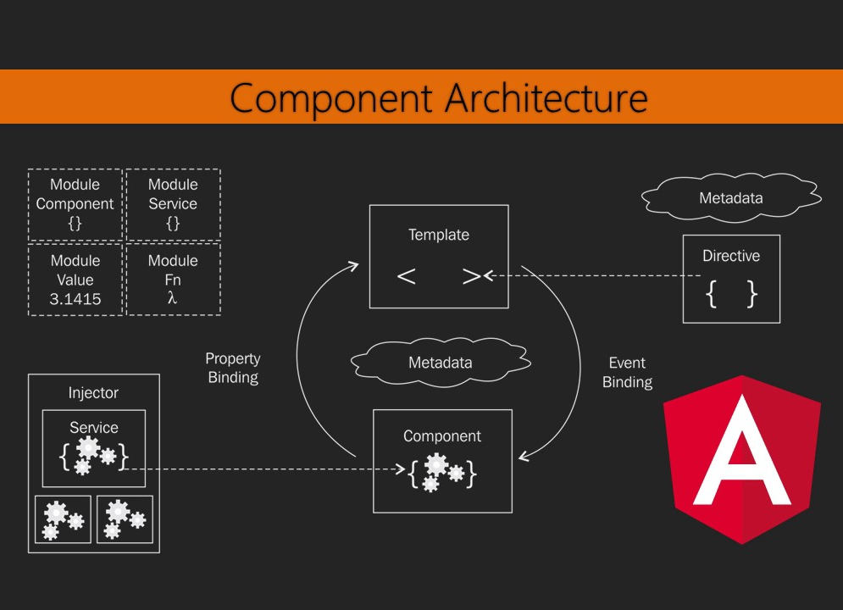
Notes:
Directives overview
There are three kinds of directives in Angular:
Components—directives with a template.
Structural directives—change the DOM layout by adding and removing DOM elements. Ex. ngIf, ngFor...
Attribute directives—change the appearance or behavior of an element, component, or another directive.

Slide 3
What are services in angular?
Service is a broad category encompassing any value, function, or feature that your application needs.
Almost anything can be a service. A service is typically a class with a narrow, well-defined purpose. It should do something specific and do it well.
Examples include:
logging service
data service
message bus
tax calculator
application configuration
Note: Angular has no definition of a service. There is no service base class.
Notes:
Broad: Amplio
Encompassing: abarcar, incluir
Narrow: angosto, reducido

Slide 4
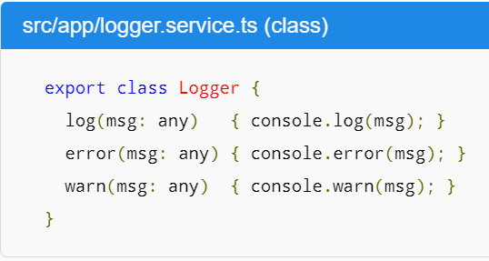
Examples

Slide 5
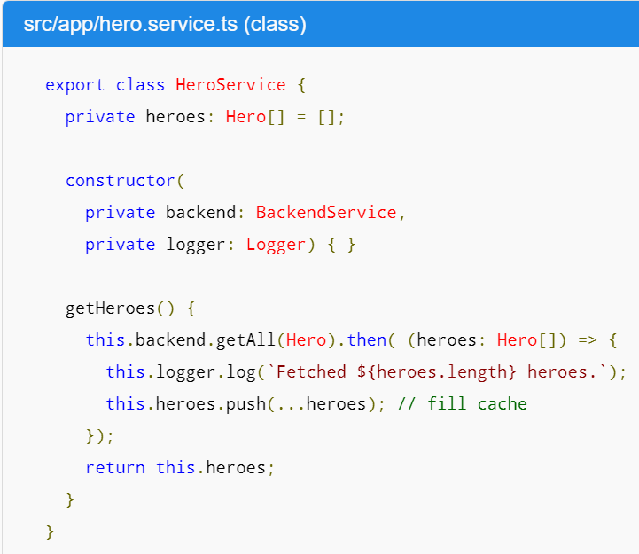

Slide 6
HttpClient module
This angular module allow us to use an API client. To use it follow this steps:
Import HttpClientModule (Just once) in app.module from @angular/common/http.
In every service inject HttpClient from @angular/common/http.
Use HttpClient methods.
Note: HttpModule from '@angular/http' is deprecated, please use '@angular/common/http' .

Slide 7
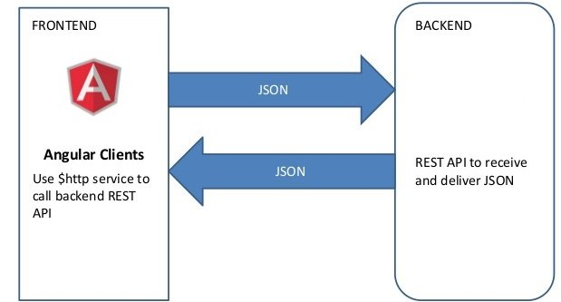

Slide 8
Promises
A Promise handles a single event when an async operation completes or fails.
A promise cannot be cancelled.
Note: There are Promise libraries out there that support cancellation, but ES6 Promise doesn't so far.
Notes:
Eric Elliott wrote Programming JavaScript Applications book
https://medium.com/javascript-scene/master-the-javascript-interview-what-is-a-promise-27fc71e77261

Slide 9
Observables
The observer pattern is a software design pattern in which an object, called the subject, maintains a list of its dependents, called observers, and notifies them automatically of any state changes, usually by calling one of their methods.
Observable is a JavaScript implementation of the observer pattern. An Observable is like a Stream and allows to pass zero or more events where the callback is called for each event.

Slide 10
Why observables over promises?
Often Observable is preferred over Promise because it provides the features of Promise and more.
It doesn't matter if you want to handle 0, 1, or multiple events.
Can be cancelable (If the result of an HTTP request to a server or some other expensive async operation isn't needed anymore, the Subscription of an Observable allows to cancel the subscription, while a Promise will eventually call the success or failed callback even when you don't need the notification or the result it provides anymore).
Provides operators like map, forEach, reduce, ... similar to an array
There are also powerful operators like retry(), or replay(), ... that are often quite handy.

Slide 11
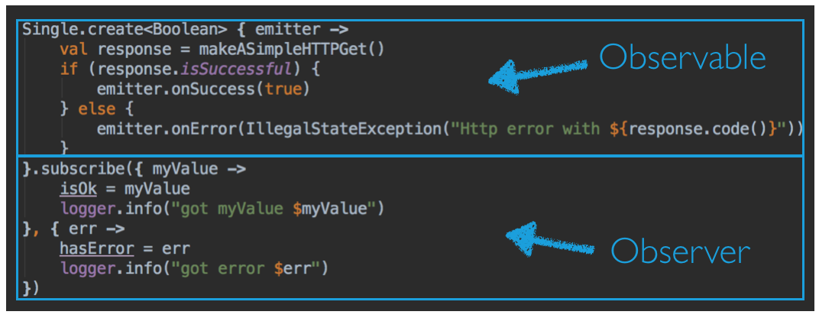

Slide 12
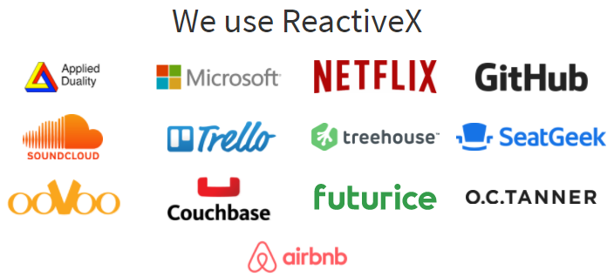
RxJS of ReactiveX
ReactiveX define themself like "An API for asynchronous programming with observable streams"
Notes:
stream: flujo
https://medium.com/@jorgeucano/30-d%C3%ADas-con-rxjs-d%C3%ADa-1-e911e68f6063

Slide 13
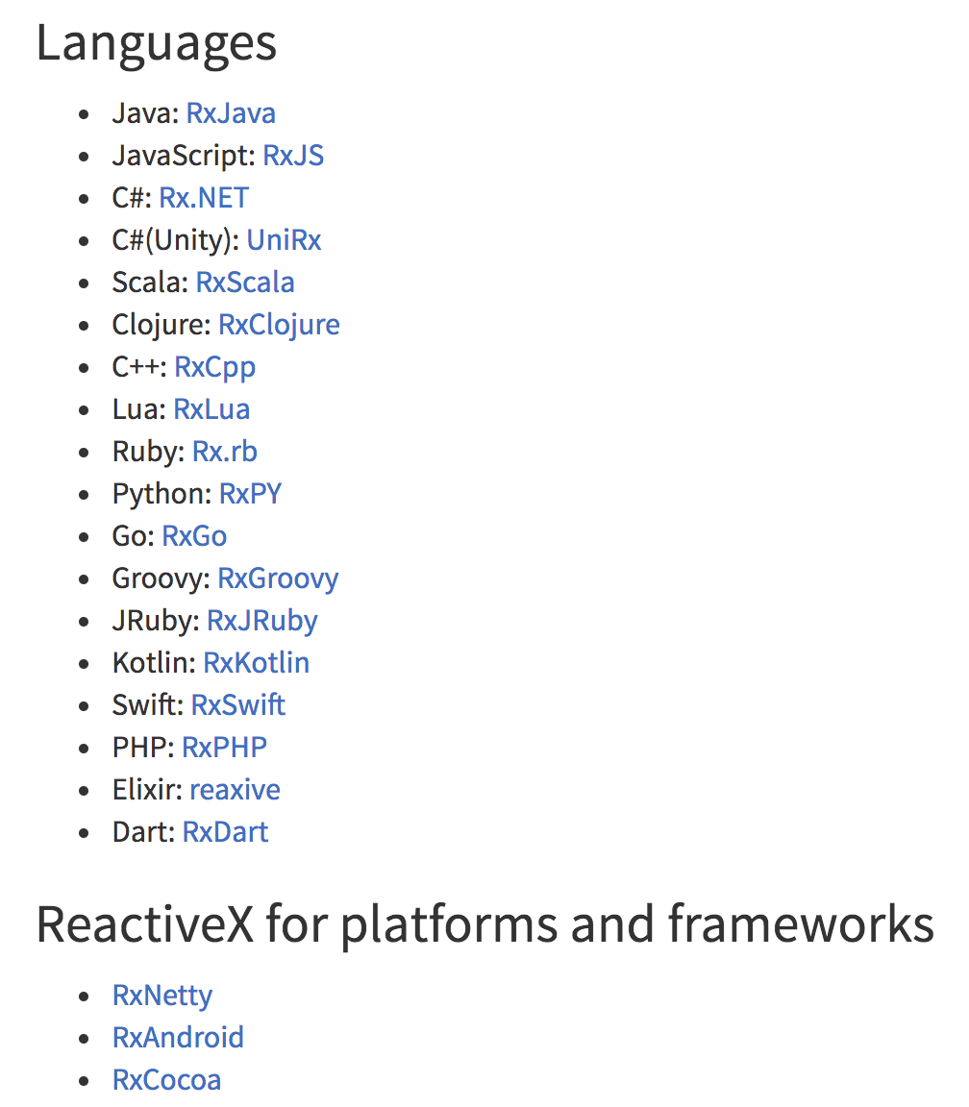
They created a library set Rx* for 18 languages, and 3 frameworks and platforms

Slide 14
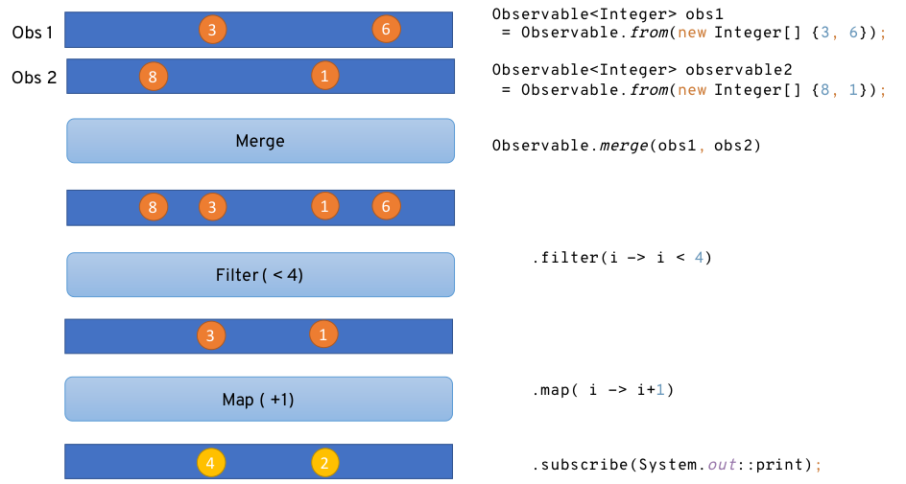
RxJS

Slide 15
Let’s code
Notes:
https://jsonplaceholder.typicode.com/

Slide 16
Resources
https://github.com/santiagocano6/Talk-Angular-HttpServicesAndObservables (Code and slides)
https://angular.io/guide/http (Documentación del HttpClient)
https://angular.io/tutorial/toh-pt4 (Tutorial services)
https://workshops-6e01c.firebaseapp.com/home (jorge cano, rxjs)
https://medium.com/@jorgeucano/30-d%C3%ADas-con-rxjs-d%C3%ADa-1-e911e68f6063 (jorge cano, rxjs)
Notes:
Aclarar como se sabe si el componente está deprecado

Slide 17
Q & A

